Slide 1
Living Donor Society
Team:
Phoebe Shubsuwan Roxanne Aceves Stephono Griffin
CSC 686
National University
8/28/2019

Slide 2
Agenda
Design Overview
Prototype
Code/phpMyAdmin (5 Min)
Website (15 Min)
5 Minutes
20 Minutes (Prototype)

Slide 3
Design Overview

Slide 4
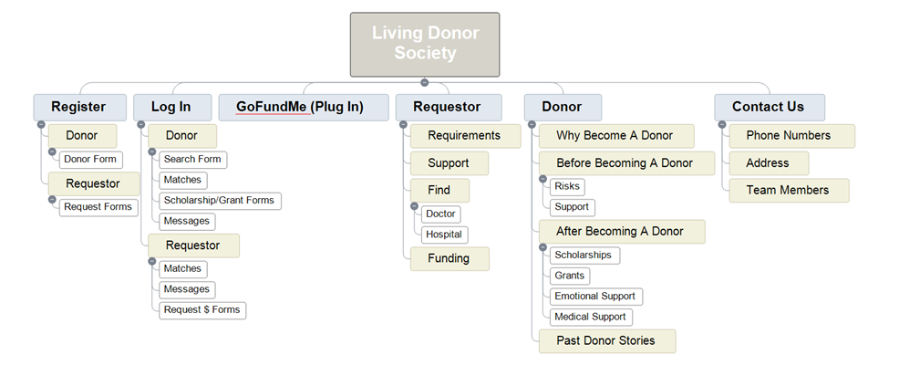
Site Map
Create a single platform that brings it all together
Original Design –
Website’s minimum requirements
Current XML Site Map–
https://shussmedia.com/wordpress/sitemap-1.xml

Slide 5
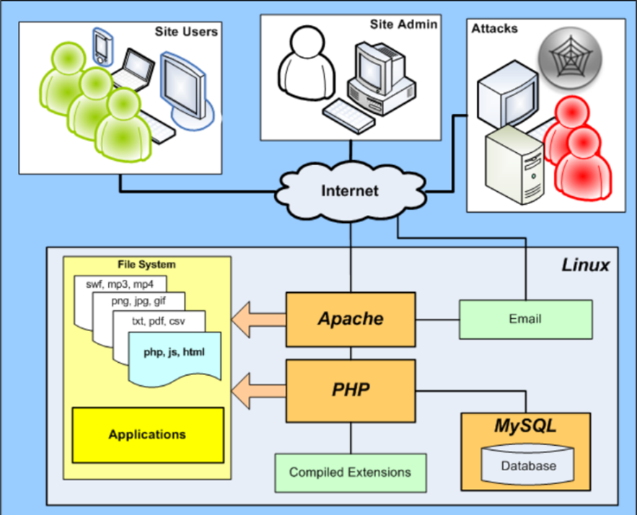
Architecture Diagram
System
Found at: https://apachebooster.com/kb/apache-web-server-and-its-overall-working-in-detail/

Slide 6
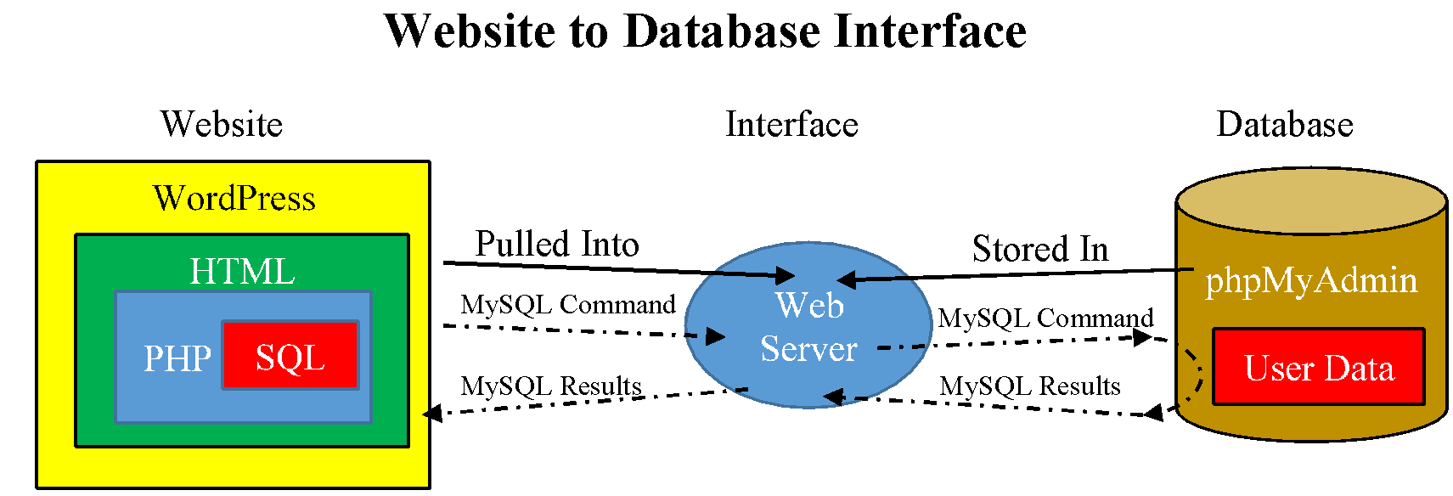
Interface Design
Benefits:
Wide spread usage of web-based solutions
Bring people together and offer services

Slide 7
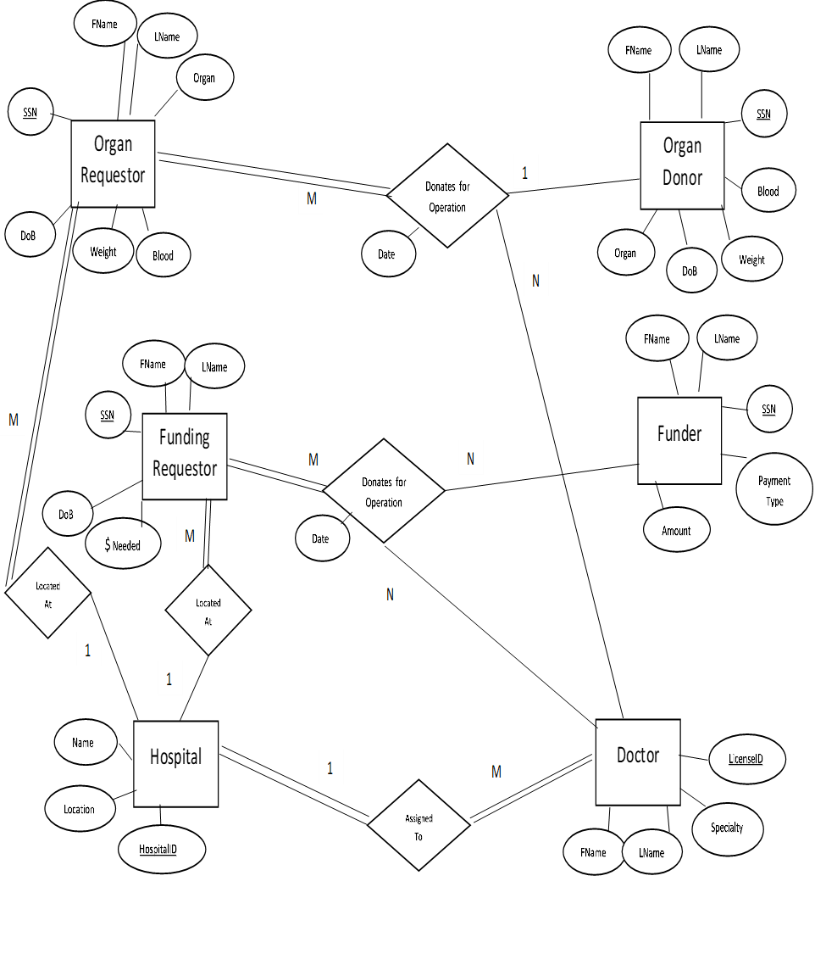
Original Database Design
ERD

Slide 8
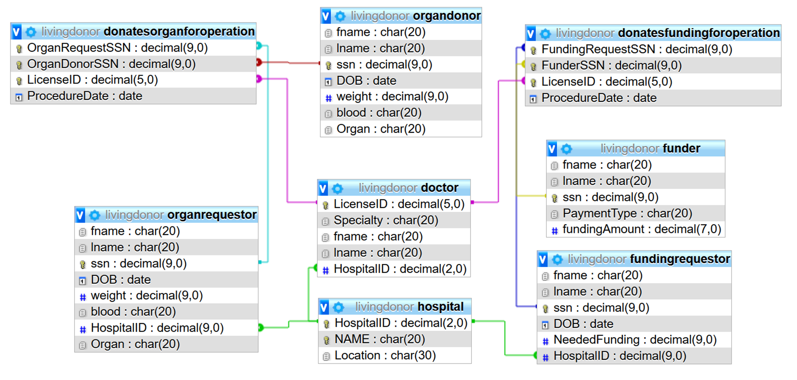
phpMyAdmin ERD

Slide 9
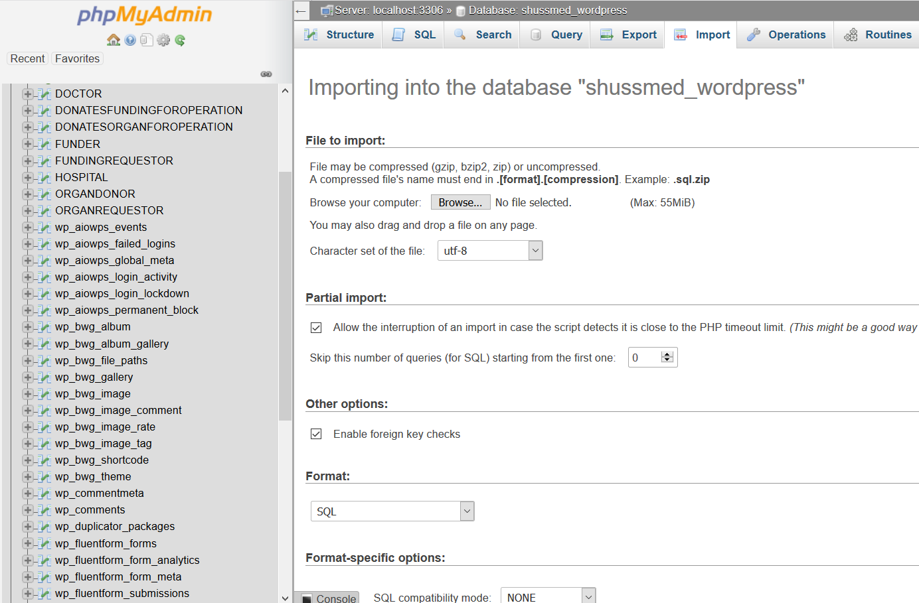
PHPMyAdmin – all tables

Slide 10
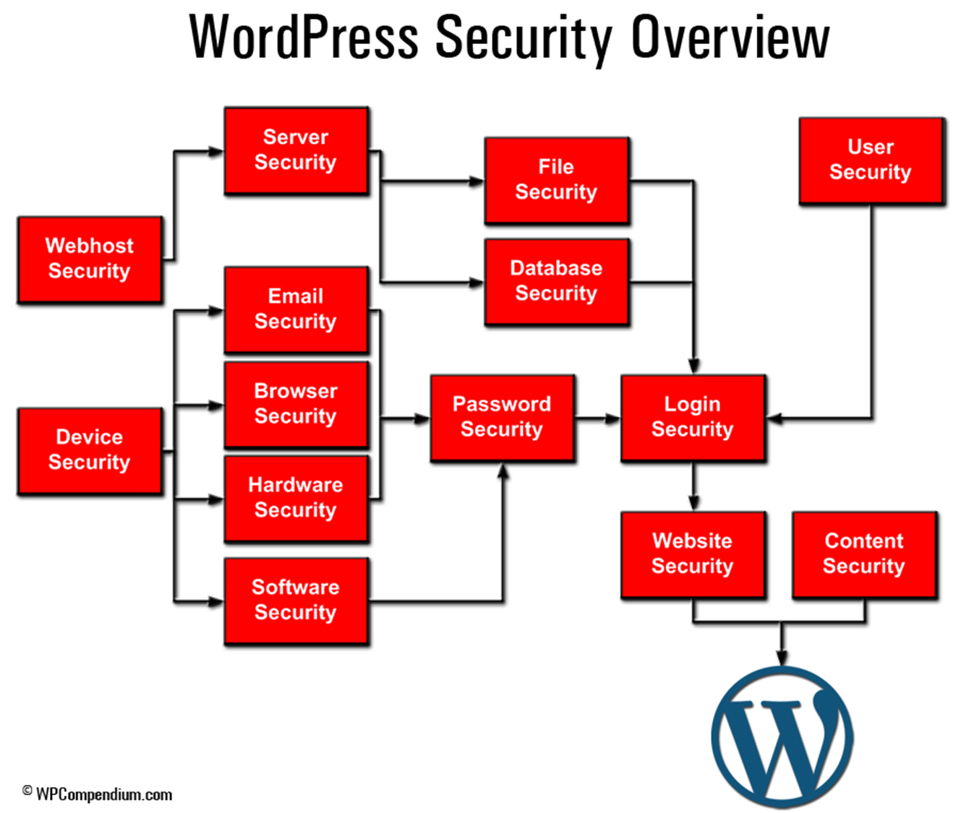
Platform Security
https – the communication is encrypted from sender to receiver
Google reCaptcha - to verify users not robots
To connect to database
-Wp-config.php – modify this page
Found At: https://wpcompendium.org/wordpress-security/wordpress-security-guide-for-beginners/

Slide 11
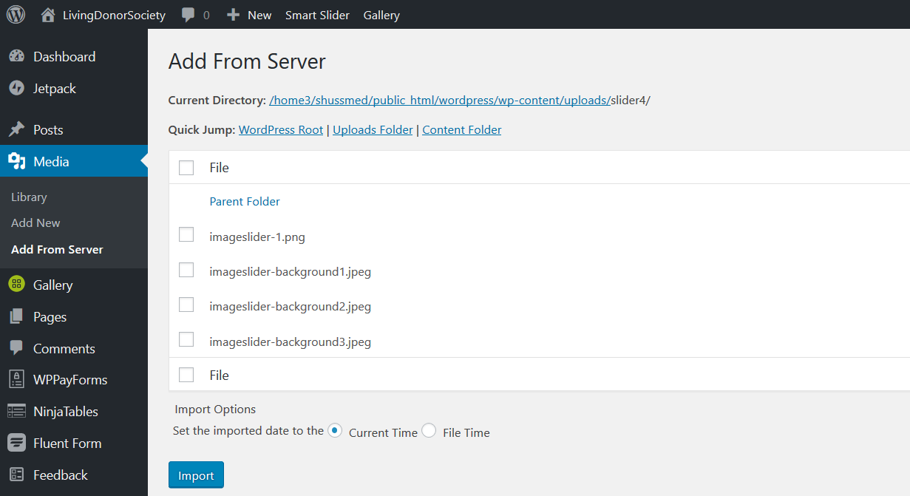
Code: Server Host

Slide 12
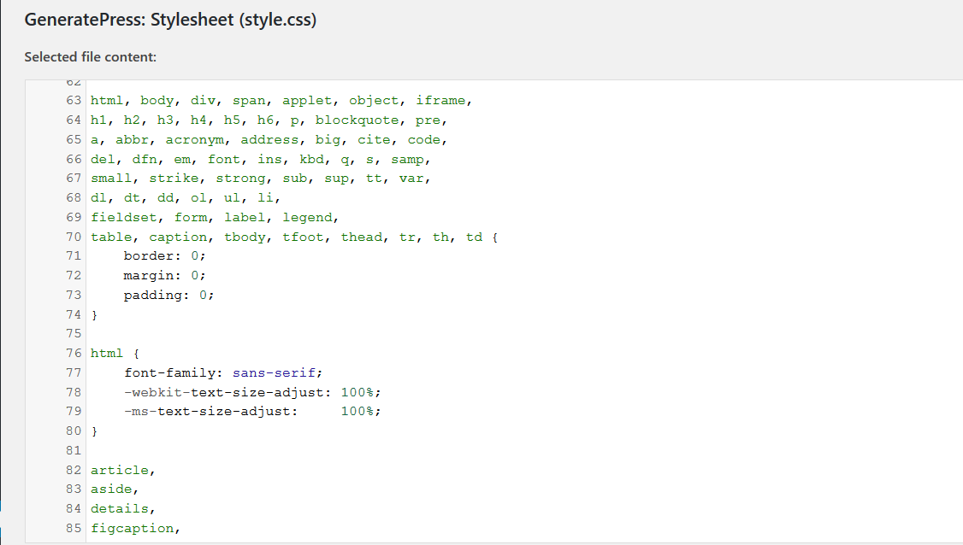
Code: Style.css

Slide 13
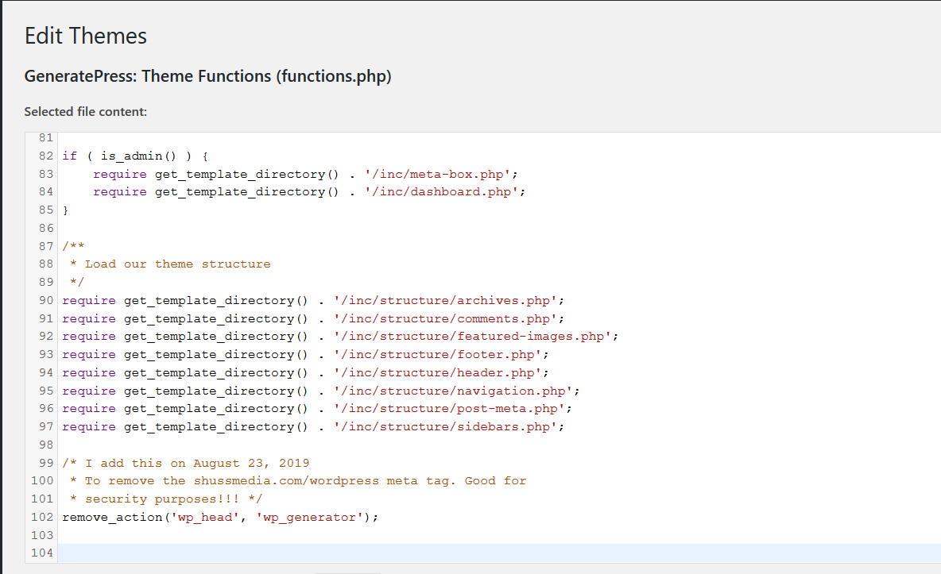
Code: Functions
To remove meta data tag from the website

Slide 14
Code: Main

Slide 15
Prototype Builds
Original Design:
Using Adobe XD a demo was performed to gain initial buy-in and feedback
Current Prototype:
WordPress based Website
Multiple Versions:
Controlled by internal processes:
Version Numbers
Lead Coders Sign off
Back-Ups of previous copies saved
Constant communication and testing is Key

Slide 16
Adobe XD Design Original Design
LivingDonorSociety Current Prototype

Slide 17
future
Continue build of the Website
Add style and formatting throughout
Test… Test… and More Testing
Fix Issues
Notes:
Image From: Miller, K. (2014, May 10). Which country has the highest organ donation rates? Retrieved from https://www.pbs.org/newshour/health/country-highest-organ-donation-rates

Slide 18
Sources (references)
Finger Lakes Donor Recovery Network. (2019, January 7). Organ Donation and Transplant Statistics. Retrieved from http://www.donorrecovery.org/learn/organ-donation-transplant-statistics/
Ledergerber, F. (2016, April 20). Organ Donation. Retrieved from http://www.ufmcpueblo.com/organ-donation/
HighCourtEnforcementGroup. (2016, November 21). Eviction of residential tenants Q&A - Part two. Retrieved from https://www.landlordreferencing.co.uk/blog/eviction-of-residential-tenants-qa-part-two/
Miller, K. (2014, May 10). Which country has the highest organ donation rates? Retrieved from https://www.pbs.org/newshour/health/country-highest-organ-donation-rates
UnityPoint Health Des Moines. (2019, April 25). Save A Life: Become an Organ Donor Today. Retrieved from https://www.unitypoint.org/livewell/article.aspx?id=162bc67a-5620-464a-875a-470d1f0dbf9f&Save A Life: Become an Organ Donor Today

Slide 19
Discussion
Image From: HighCourtEnforcementGroup. (2016, November 21). Eviction of residential tenants Q&A - Part two. Retrieved from https://www.landlordreferencing.co.uk/blog/eviction-of-residential-tenants-qa-part-two/
Notes:
Image From: HighCourtEnforcementGroup. (2016, November 21). Eviction of residential tenants Q&A - Part two. Retrieved from https://www.landlordreferencing.co.uk/blog/eviction-of-residential-tenants-qa-part-two/

